Slide 1
What is JQuery?
Ans:
j Query is a fast, small, and feature-rich JavaScript library. It makes things like HTML document traversal and manipulation, event handling, and animation much simpler with an easy-to-use API that works across a multitude of browsers. jQuery is one of the most popular and widely used JavaScript libraries, and it simplifies the process of developing web applications by providing a set of convenient methods and utilities for common tasks.
Here are some of the key features and uses of jQuery:
DOM Manipulation: jQuery allows you to easily select and manipulate HTML elements in the Document Object Model (DOM). You can change content, attributes, and styles of elements with concise and readable code.
Event Handling: jQuery simplifies event handling. You can attach event handlers to elements, such as click or hover events, with ease.
Animations: You can create animations and transitions in your web pages using jQuery. This includes effects like fading in/out, sliding, and more.
Cross-Browser Compatibility: jQuery handles many cross-browser compatibility issues, ensuring that your code works consistently on various web browsers.
Simplifies JavaScript: jQuery simplifies many common JavaScript tasks, making it easier for developers to work with and understand.
Here's an example of how you might use jQuery to add a click event handler to a button element with the ID "myButton" and change the text of a paragraph with the ID "myParagraph" when the button is clicke

Slide 2
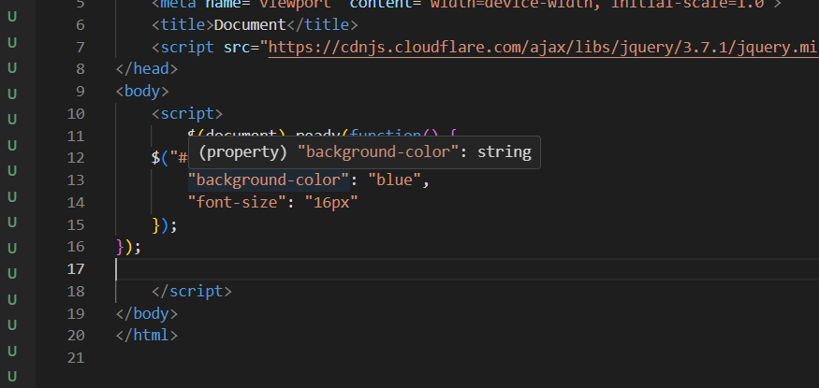
2.How to Apply CSS Using JQuery, How to Add Class and Remove Class in JQuery, JQuery Animation?
Ans: You can apply CSS, add and remove classes, and create animations using jQuery. Here are examples of how to do each of these tasks:
Applying CSSa using jQuery: To apply CSS styles to HTML elements using jQuery, you can use the css method. Here's an example of how to change the background color and font size of an element with the ID "my Element

Slide 3
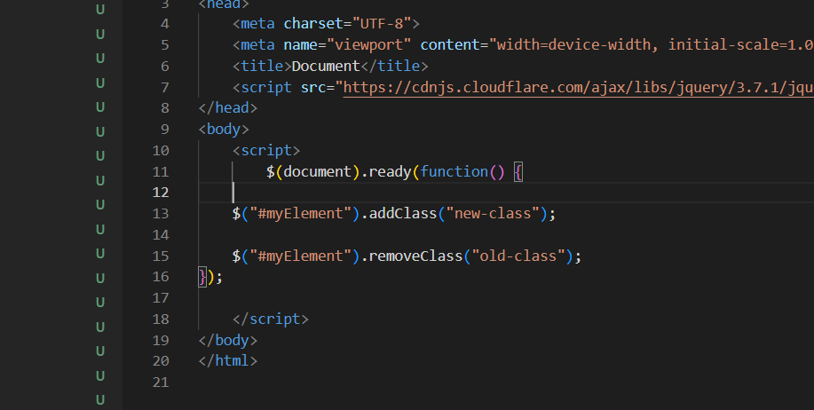

Slide 4
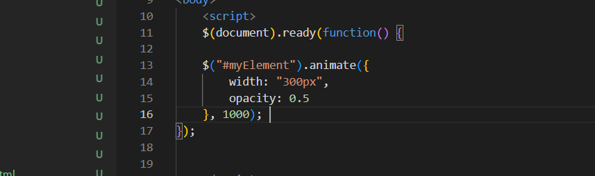
3. jQuery Animation: jQuery provides several methods for creating animations on HTML elements, including
Animate(),fadein(), fadeout() and so on…
4. How to create slider with animation?
Ans:Creating a slider with animation can be done using HTML, CSS, and JavaScript. A slider typically consists of a set of images or content that you can cycle through using navigation buttons or by automatically transitioning between them. Here's a step-by-step guide on how to create a basic slider with animation:
HTML Structure:
Start by creating the HTML structure for your slider. You can use an unordered list <ul>to hold the slide items, and each list item <li> will contain the content or image for each slide.

Slide 5
CSS Styling:
Style your slider with CSS. You can set the dimensions, position, and styles for the slider and individual slides. Additionally, you can hide all slides except the first one to start with.
javaScript for Animation:
To create animation, you'll need JavaScript to handle the transition between slides. You can use JavaScript to change the transfer property to slide the images horizontally.
HTML Structure:
Start by creating the HTML structure for your slider. You can use an unordered list <ul>to hold the slide items, and each list item <li> will contain the content or image for each slide.

Slide 6
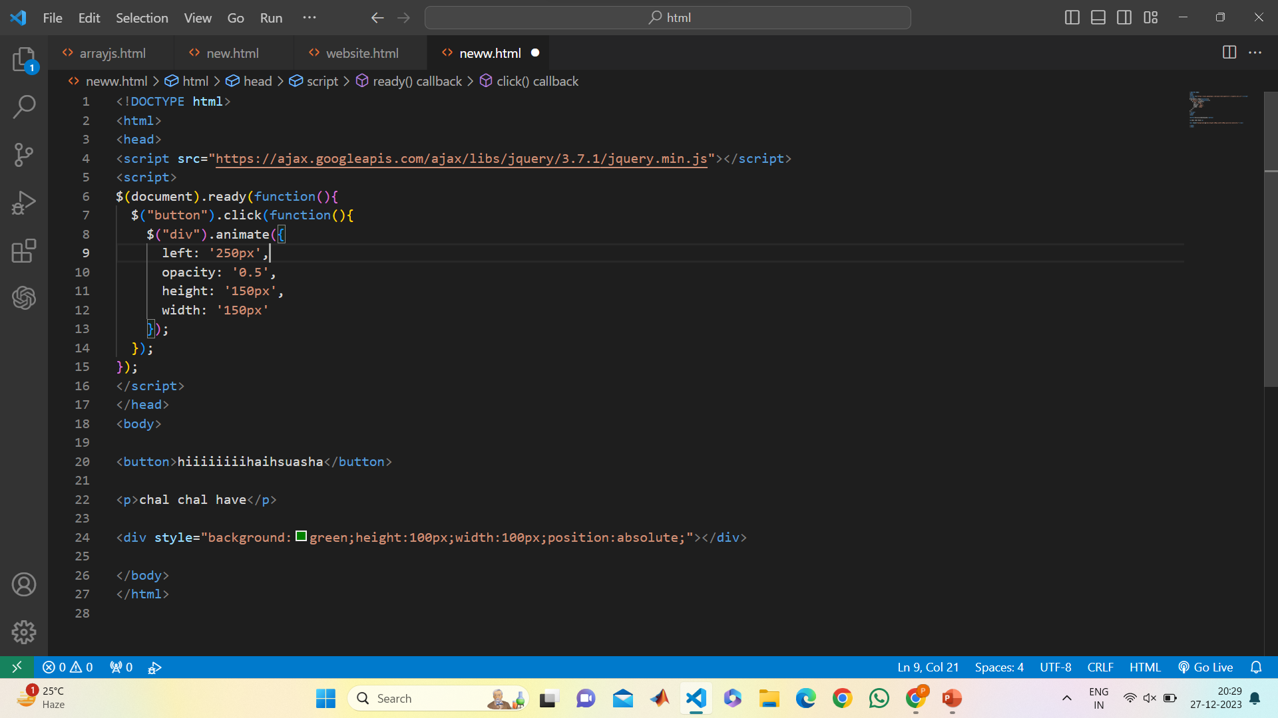
You can see this is screenshort of animation

Slide 7
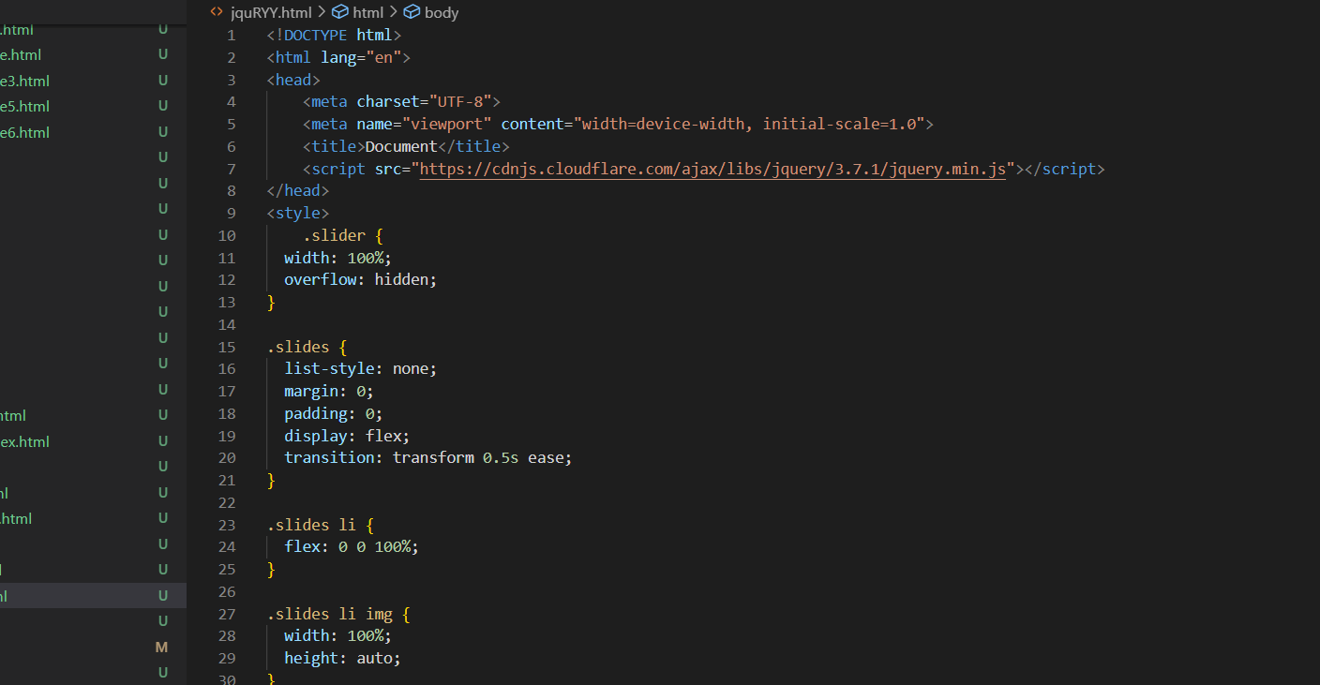

Slide 8
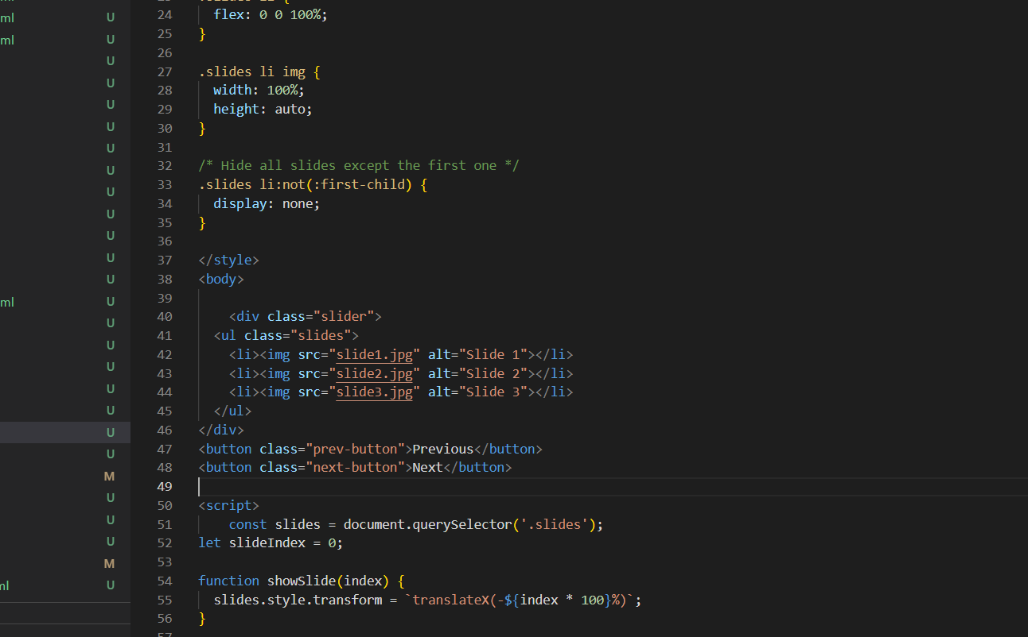

Slide 9
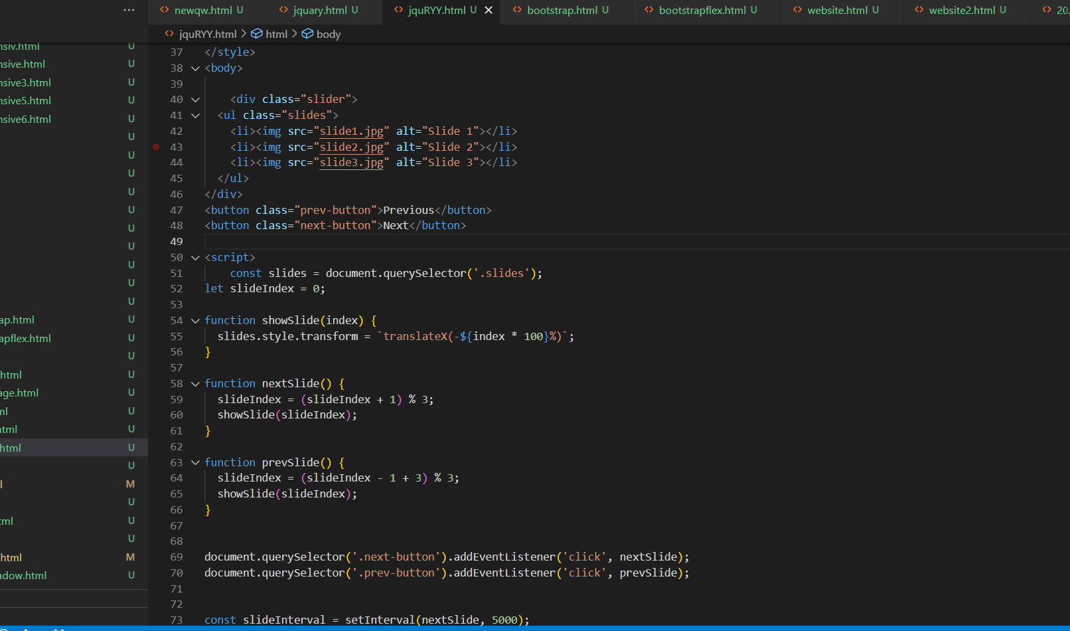

Slide 10
